Slide 1
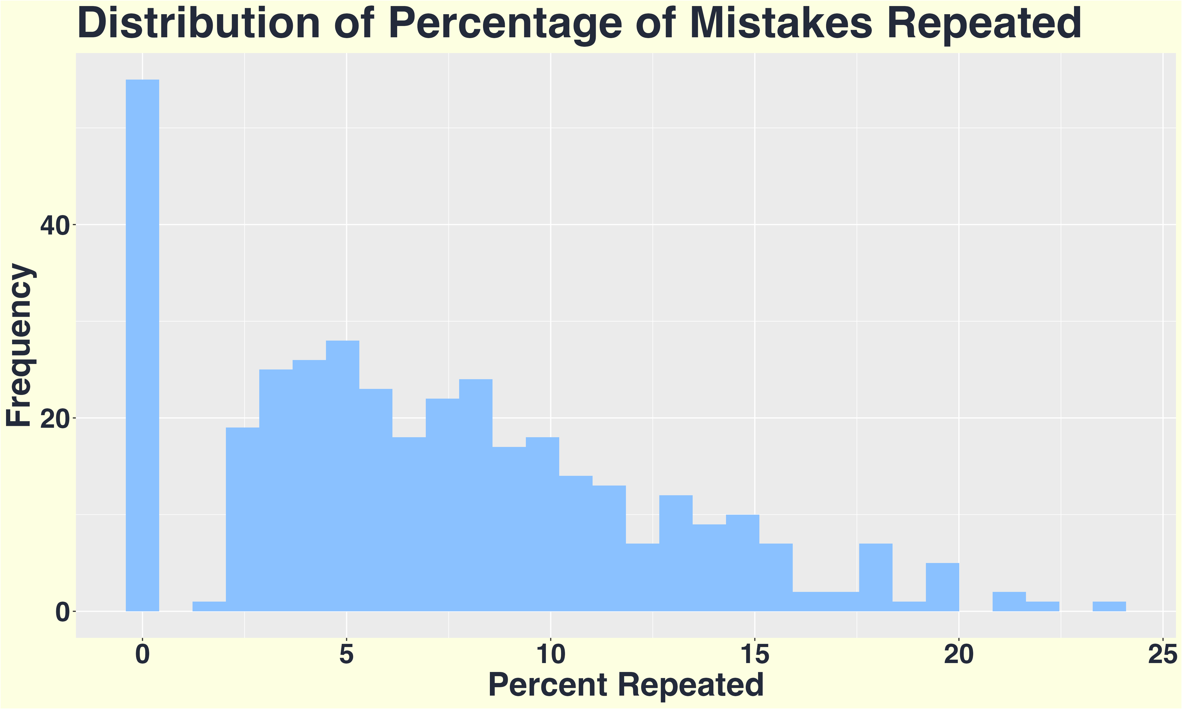
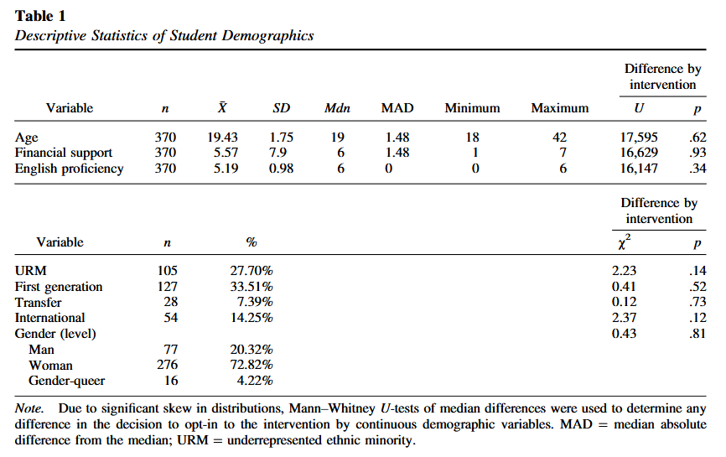
Unlocking Feedback Generalization:
The Relationship Between Metacognition, Feedback Viewing and Repeated Mistakes
Xinhui Zhang, Sydney Wood, Victoria Cross
Background
Results
Sample Demographics
Scaffolding provides a framework for teaching students to develop feedback literacy through iterative feedback. Feedback literacy is learners’ ability to understand and apply feedback. Instructors aim to foster feedback literacy by giving feedback that prompts deeper connections through contextualization and broad application. The current study examines the change of repeated mistakes over time in the context of metacognitive intervention.
Predictions
Hypothesis 1: Overall, students repeat a smaller percentage of mistakes on questions that are repeatedly tested.
Hypothesis 2: Students who view feedback repeat a smaller percentage of mistakes on subsequent exams than those who did not view feedback.
Hypothesis 3: Controlling for feedback viewing, students in the intervention group repeat a smaller percentage of mistakes on exams after the intervention compared to before the intervention and compared to students who did not opt in to the intervention
Conclusion
Comment on non-normal distribution
Model 2
Percentage of Repeated Mistakes Over Time by Feedback Viewing and Intervention Group
FIXED EFFECTS: |  |  | β | S.E. | t | df | p
Intercept (Opt-out | Not Viewed | Time1) |  |  | 14.79 | 4.3 | 3.48 | 15.44 | <.005
Opt-out | Not Viewed | Time2 |  |  | -6.76 | 1.7 | -4 | 57.15 | <.001
Opt-out | Not Viewed | Time3 |  |  | -17.49 | 2.3 | -0.6 | 22.13 | <.001
Opt-out | Not Viewed | Time4 |  |  | -15.74 | 2.7 | -5.8 | 12.64 | <.001
Opt-in | Not Viewed | Time 1 |  |  | 0.13 | 1.8 | 0.07 | 6764.07 | 0.94
Opt-out | Viewed | Time 1 |  |  | 1.53 | 1.4 | 1.13 | 12931 | 0.26
Opt-in | Not Viewed | Time 2 |  |  | 0.99 | 2 | 0.49 | 13957.5 | 0.63
Opt-in | Not Viewed | Time 3 |  |  | -0.79 | 2.8 | -0.3 | 13933.6 | 0.78
Opt-in | Not Viewed | Time 4 |  |  | -1.17 | 1.9 | -0.6 | 13919.4 | 0.54
Opt-out | Viewed | Time 2 |  |  | -2.97 | 1.6 | -1.8 | 13948 | 0.07
Opt-out | Viewed | Time 3 |  |  | 0.36 | 1.7 | 0.21 | 13956.8 | 0.84
Opt-out | Viewed | Time 4 |  |  | -0.19 | 1.5 | -0.1 | 13812.3 | 0.9
Opt-in | Viewed | Time1 |  |  | -4.61 | 2 | -2.3 | 13333.7 | 0.02
Opt-in | Viewed | Time2 |  |  | 2.77 | 2,46 | 1.12 | 13919.1 | 0.26
Opt-in | Viewed | Time3 |  |  | 3.35 | 3.1 | 1.08 | 13903.1 | 0.28
Opt-in |Viewed | Time4 |  |  | 5.28 | 2.3 | 2.28 | 13696.9 | 0.02
RANDOM EFFECTS: | Group |  | σ² | σ | n | ICC
student_id |  |  | 35.01 | 5.9 | 369 | 0.07
question_id |  |  | 77.06 | 8.8 | 9 | 0.16
attempt |  |  | 6.92 | 2.6 | 4 | 0.01
Methods
Participants: 370 undergraduates in a research method course.
Intervention: Optional metacognitive exam corrections after Exam 3.
Measure:
Repeated mistakes (matched rubric items across scaffolded exams).
Analysis:
Two Multilevel mixed-effects models estimated with Restricted Maximum Likelihood and Satterthwaite's t-test method
References
Reference one
Reference two
Reference three
Reference four
Reference five

